Slide 1
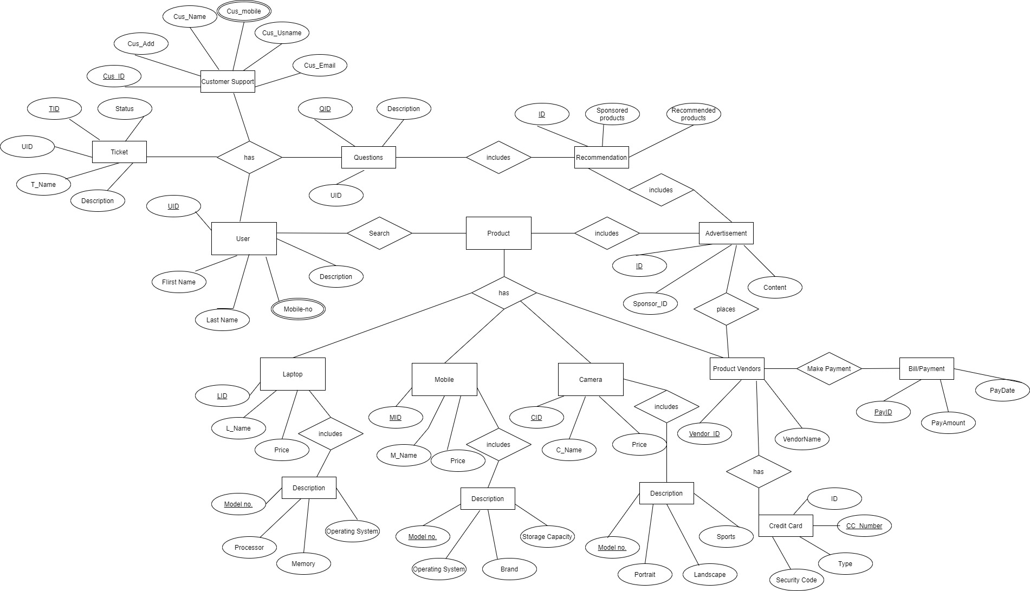
Conceptual ER Diagram Tech Selector Website

Slide 2
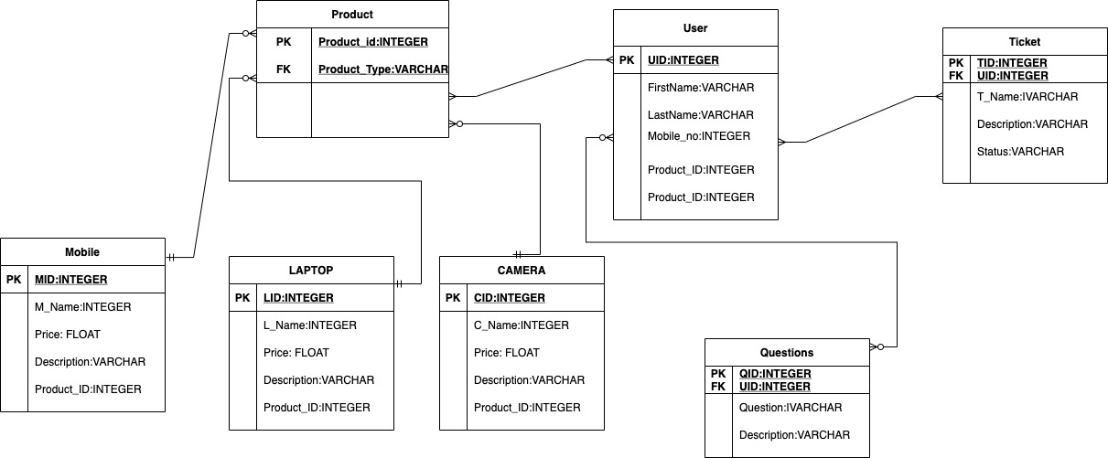
Logical ER Diagram Tech Selector Website

